Slide 1
Probability and statistics 10-Discrete prior & posterior probability
상명대학교 휴먼지능정보공학과

Slide 2
Learning from experience
Which treatment would you choose?
1. Treatment 1: cured 100% of patients in a trial.
2. Treatment 2: cured 95% of patients in a trial.
3. Treatment 3: cured 90% of patients in a trial.
Which treatment would you choose?
1. Treatment 1: cured 3 out of 3 patients in a trial.
2. Treatment 2: cured 19 out of 20 patients treated in a trial.
3. Standard treatment: cured 90000 out of 100000 patients in clinical practice.

Slide 3
Which die is it?
I have a bag containing dice of two types: 4-sided and 10-sided.
Suppose I pick a die at random and roll it.
Based on what I rolled which type would you guess I picked?
Suppose you find out that the bag contained one 4-sided die and one 10-sided die. Does this change your guess?
Suppose you find out that the bag contained one 4-sided die and 100 10-sided dice. Does this change your guess?

Slide 4
Terminologies
세 가지 종류의 동전이 있으며 각각 A, B, C라고 한다.
각각 0.5, 0.6, 0.9의 확률로 Head가 나온다.
A종류 2개, B종류 2개, C종류 1개의 동전이 항아리 안에 있다.
어떤 동전인지 모르는 상태로 하나를 골라 던졌는데 Head가 나왔다.
어떤 종류의 동전인가?
이를 위해, D가 한번 던져 Head가 나온 event라고 할 때, P(A|D), P(B|D), (C|D)를 알아야 한다.
여기서
Data: 실험의 결과. 이 경우 D=‘H’.
Hypothesis: 이 경우 세 가지의 가설이 존재한다. 동전의 종류가 A, B, 혹은 C.
Prior probability (이전 확률): Data를 얻기 전 각 가설의 확률. P(A), P(B), P(C).
Likelihood: P(D|H). 이 경우 P(D|A)=0.5, P(D|B)=0.6, P(D|C)=0.9.
Posterior probability (이후 확률): 데이터를 얻은 후의 각 가설의 확률. P(A|D), P(B|D), P(C|D).

Slide 5

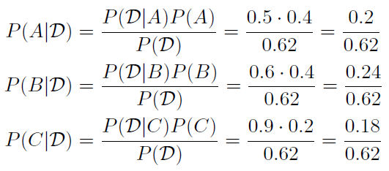
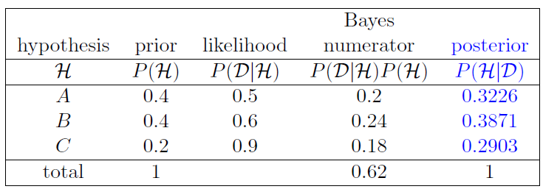
Bayes’ theorem in tabular form
Bayes’ theorem:
The law of total probability gives:
Posterior probabilities:
Bayesian update table

Slide 6

Bayesian updating
The process of going from prior P(H) to posterior P(H|D) is called Bayesian updating.
The Bayes numerator column determines the posterior probability column. We can approximate as
The MLE for this example is hypothesis C. The MLE is useful, but you can see in this example that there are more things to consider.

Slide 7
Question: learning from data
Redo the previous example with D=‘Tail’.

